Slide 1
Personal Health and Wellness
Unit 4
6th

Slide 2
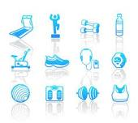
What is fitness?
WHEN YOU THINK FITNESS ,WHAT WORDS COME TO MIND?

Slide 3
Fitness
Gives you enough energy to last the whole day
Helps keep your weight at a healthy level for you
Helps you deal with the ups and downs of life
Gives you self confidence –more likely to succeed
Makes your life more fun

Slide 4
Fitness is more than being physically healthy…
Physical benefits
Mental benefits
Social benefits
Notes:
Physical benefits – exercise builds strong muscle, relieves stiffness, adds coordination, good for heart and lungs, helps maintain a desirable weight
Mental benefits – Feel more energetic, you’ll get tired less easily, relieve stress, feel proud of what you have accomplished
Social benefits – exercise can be done with a group, meet new people, motivates you to keep going when you want to quit, friends can encourage you and cheer you on

Slide 5
Thoughts…

