Slide 1
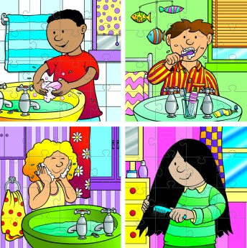
What is personal hygiene?
How do I keep my skin, hair, and teeth healthy?

Slide 2
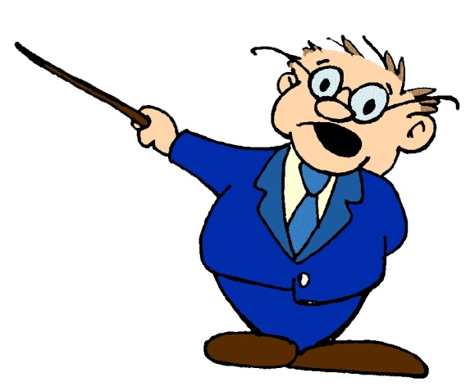
Peer Teaching Posters
6 groups
Responsibility
Respect
Productive
Group 1 Group 2 Group 3
TEETH SKIN HAIR
Group 4 Group 5 Group 6
EARS EYES ALL

Slide 3
TIME
2 minutes - brainstorm all the words your groups associates with your topic
20 minutes - use the book to gather facts make a poster plan
30 minutes – decorate poster
30 minutes – groups will present their facts with your poster
*Group with the best presentation gets candy
Create a CROSSWORD PUZZLE using words from all sections

Slide 4
Personal hygiene
Hygiene refers to the set of practices associated with the preservation of health and healthy living.
Personal hygiene involves properly caring for your body by keeping it clean and healthy while allowing you to look and feel your best.

Slide 5
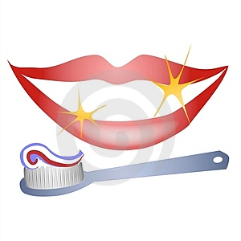
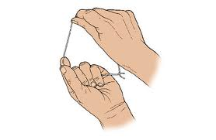
TEETH
Affect your health and appearance
Attending everyday (at least 2x and floss)
Get teeth checked (every 6 months)
Eating right helps have strong teeth
Enamel – covers crown (coating)
Tooth decay caused by food and bacteria
Plaque – sticky substance we can remove
Tartar – hard substance we ourselves cannot remove
Prevent worse problems (cavities, gingivitis, tooth decay) by brushing, flossing, and going to the dentist

Slide 6
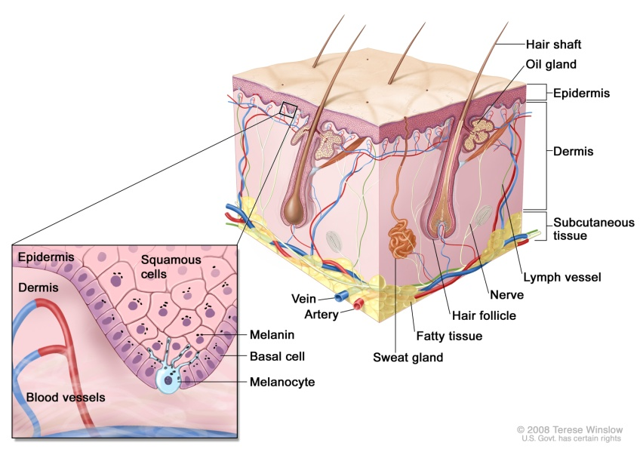
SKIN
Largest body organ
Epidermis – outer layer that makes new skin cells and Dermis
Functions
Protects from germs
Controls body temperature (sweat glands)
Eliminates wastes
Shields against water
Tells us about the world
Keep it clean (regular washing) *sweat glands acne
Protect it (strongest rays from 10-2 use at least 15 SPF)
Eat sensibly (especially Vitamin A prevents skin cancer)
Get plenty of exercise and sleep (glow)
Dermatologist (skin doctor)

Slide 7
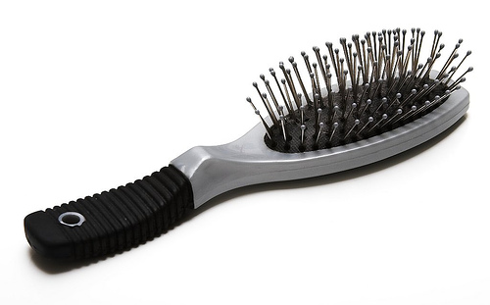
HAIR
Best hair styles are ones that are clean
Fastest growing part of your body
Passed on by parents (melanin)
Hair shaft determines straight, curly, wavy
WASH often (shampoo and conditioner)
BRUSH regularly (oils)
Dandruff – dry scalp (dead skin)
Lice – medicated shampoo and precaution
Blow drying or straightening, putting it in a pony can damage your hair

Slide 8
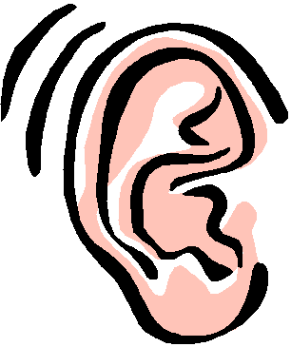
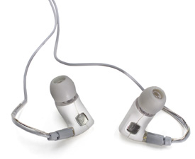
EARS
Help you talk
Help you listen to music
Help you keep balance
Protect them from cold
Protect them from loud sounds
Decibels – how sound is measured *sounds louder than 80 or 90 can cause damage (permanent and temporary hearing loss)

Slide 9
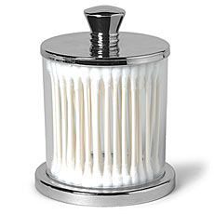
Q-tips
yay or nay

Slide 10
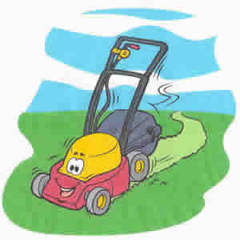
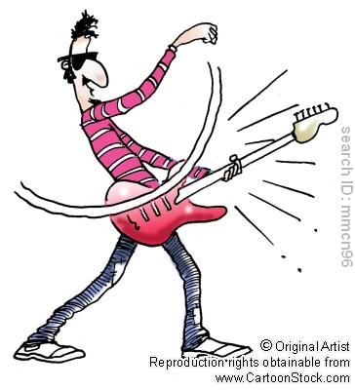
EARS
Conversation – 60 decibels
Lawnmower – 90 decibels
Concert – 110 decibels

Slide 11
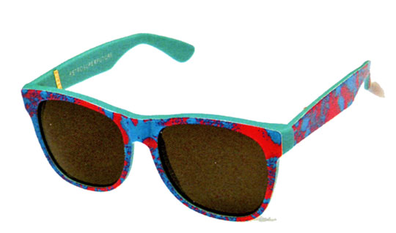
EYES
Protect your eyes from eyestrain – read and watch TV in a well lighted room, shine light on what you are reading, sit a comfortable distance (at least 6 feet) from the TV,
Protect your eyes from infection – do not rub your eyes
Get regular checkups – every year if you wear glasses and every 2 years if you do not (Optmologist)
Protect your eyes from injury – safety goggles,
visor, safety eyewear, avoid rubbing, rinse out
by splashing

Slide 12
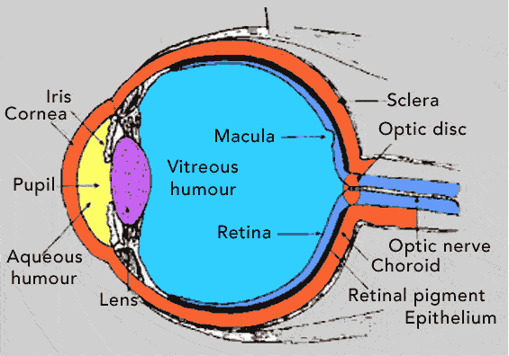
EYES
Farsightedness – can’t see close distances
Nearsightedness – can’t see long distances
Astigmatism – blurred vision (cornea or lens)
Use eyeglasses or contact lenses depends on vision problem
Keep lenses clean to avoid infection

Slide 13
Crossword (on a separate sheet of paper)
Pick 10+ words relating to personal hygiene
2 ear
2 eye
2 hair
2 skin
2 teeth
Make a crossword puzzle
writing out the clues
Create an unfilled crossword puzzle

